Slide 1
User Stories and Test Cases
That One Company Inc.
Michael Merritt, Jonathan Mason, Omar Rosario, William Siri

Slide 2

Instruction Screen - User Story
As a Player I want to have clear instructions on how to play the game so that I can use all the features necessary for playing.

Slide 3
Instruction Screen - Test Case
Objective: Make sure that the instruction screen is clear.
Steps:
Ensure "INSTRUCTIONS" is chosen and press the spacebar to confirm choice.
Confirm that all the Game Controls are properly displayed on the instruction screen.
Expected Results:
Instruction Screen successfully opens
Game Controls for walking, jumping, and attacking are all properly displayed.

Slide 4
Cat Sprite Flipping- User Story
As a Player I want to have the cat sprite flip mid-air so that I can determine which direction I am going in the air.

Slide 5
Cat Sprite Flipping - Test Case
Objective: Ensure that the cat sprite is facing the direction that the player is inputting while in the air.
Steps:
Ensure “PLAY GAME” is chosen and press the spacebar to confirm choice.
Use Game Controls to jump while walking forwards.
Use Game Controls to jump while walking backwards.
Use Game Controls to jump one direction and then hold the opposite the direction while in the air.
Expected Results:
Level 1 successfully starts
Avatar jumps forward and properly shows itself as facing forwards
Avatar jumps backwards and properly shows itself as facing backwards.
Avatar initially jump in the initial direction but then flips over to the other direction when the Game Controls are used to do so.

Slide 6
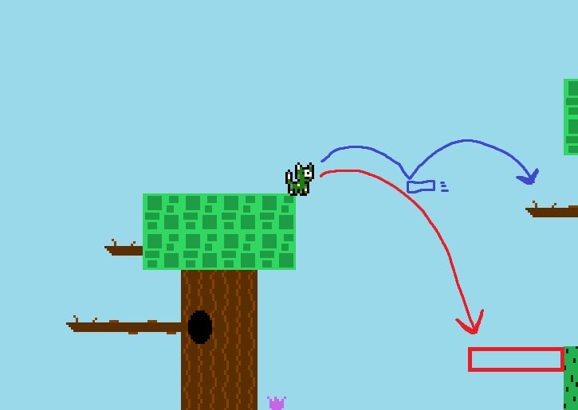
Level 3 Improvements - User Story
As a player, I want to be able to finish level three so that I can experience the rest of the game without being interrupted or having to go back to the main menu.

Slide 7
Level 3 Improvements - Test Case
Objective: Verify that the player is able to make the jump across the lake and to the yellow block to finish the level.
Steps:
Select “LEVEL SELECT” on the main menu by pressing down three times and then pressing enter.
Select “Level Three” by going down two options in the level select menu
Locate the enemy on the screen and make sure it is in an accessible area
Move the player to the top of the tree near the left of the water
Jump over the water pit to the tree on the other side of the water
Navigate to the end of the level and jump into the yellow box
Expected Results:
The level select screen opens
Level three loads correctly
Enemy is able to move, be walked into, or attacked
Player is able to climb the tree
Player is able to make the jump
Level 3 ends and level 4 begins

Slide 8
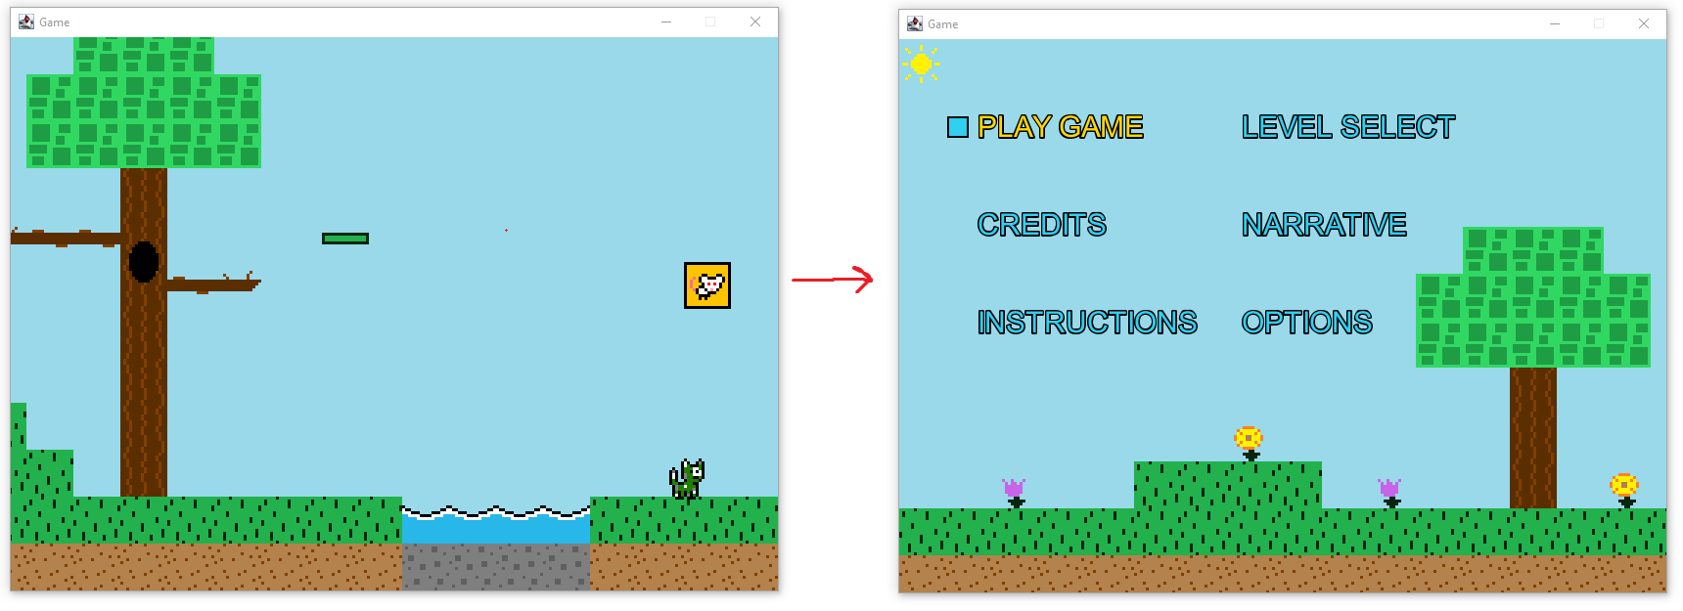
Level 5 Looping - User Story
As a player, I want to go back to the main menu after finishing level 5 so that I can return to the character or level select screens without having to lose a level first.

Slide 9
Level 5 Looping - Test Case
Objective: Verify that the player is sent back to the main menu when the yellow block is hit at the end of the last level, level 5.
Steps:
Select “LEVEL SELECT” on the main menu by pressing down three times and then pressing enter.
Select “Level Five” by going down four options in the level select menu
Navigate to the end of level five without dying to enemies or hazards
Jump into the yellow box to end the level
Expected Results:
The level select screen opens
Level five loads correctly
The player makes it near the yellow box without getting stuck
The main menu is loaded successfully

Slide 10
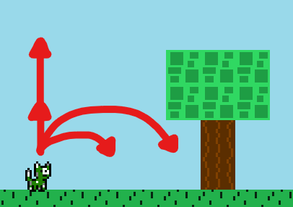
Player Movement - User Story
As a player, I want to be able to have more intricate player movement so that I can have more control over my character’s actions.

Slide 11
Player Movement - Test Case
Objective: Verify that the newly implemented movement mechanics work.
Steps:
Start up the game and select either “PLAY GAME” or “LEVEL SELECT” and choose a level to play
Hold the spacebar
Tap the spacebar
While moving, hold the spacebar
While moving, tap the spacebar
Expected Results:
You are loaded into the respective level.
The character performs a vertical jump with a greater height
The character performs a vertical jump with a shorter height
The character performs a vertical jump with a longer distance
The character performs a vertical jump with a shorter distance

Slide 12
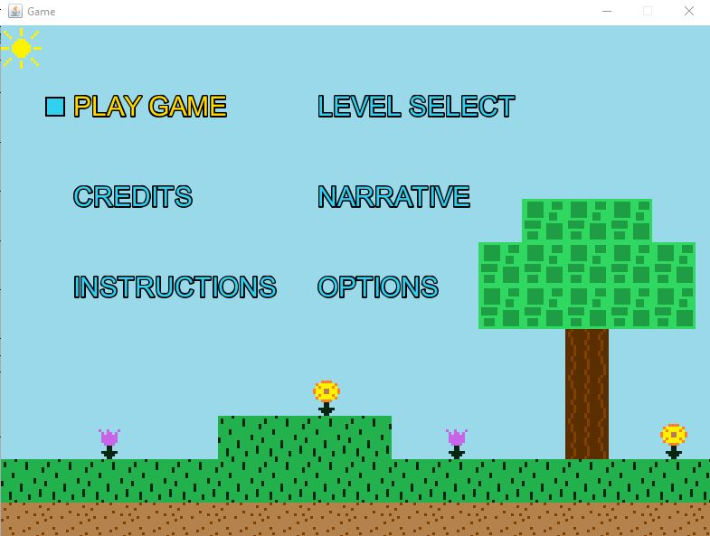
Menu Navigation - User Story
As a player, I want to be able to use WASD or the arrow keys so that I can navigate the menu in any direction

Slide 13
Menu Navigation - Test Case
Objective: Verify that the new menu controls work as intended and are interchangeable.
Steps:
Press ‘S’ or the down arrow key
Press ‘W’ or the up arrow key
Press ‘D’ or the right arrow key
Press ‘A’ or the left arrow key
Expected Results:
The section below the currently selected option becomes highlighted (“CREDITS”).
The section above the currently selected option becomes highlighted (“PLAY GAME”).
The section to the right of the currently selected option becomes highlighted (“LEVEL SELECT”).
The section to the left of the currently selected option becomes highlighted (“PLAY GAME”).

Slide 14
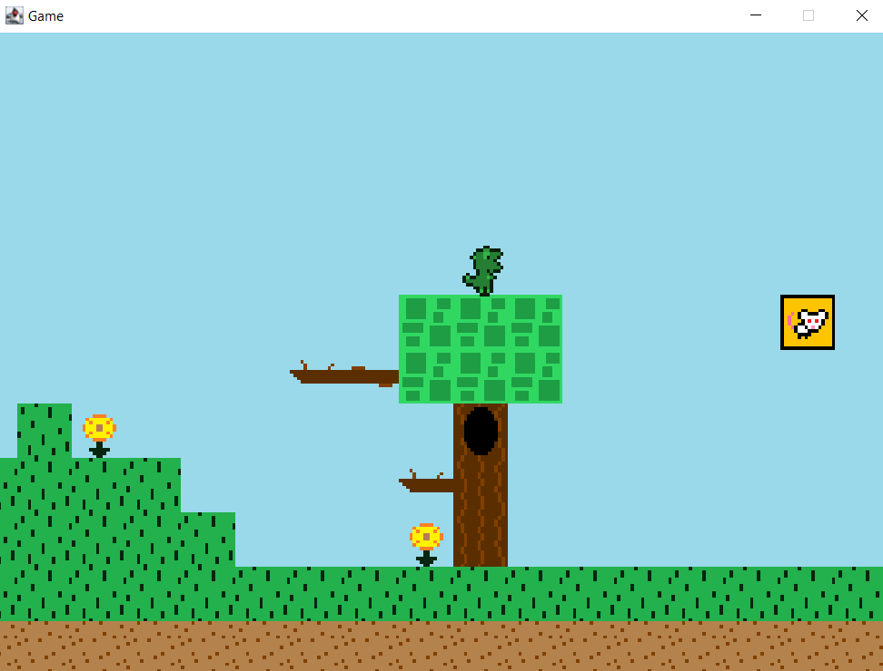
Level Boundaries - User Story
As a Player I want to have level boundaries so that I can stay inside the level without getting lost off screen

Slide 15
Level Boundaries - Test Case
Steps:
Ensure “PLAY GAME” is chosen and press the spacebar to confirm choice
Use Game Controls to walk towards the Left Level Boundary of Level 1
Use Game Controls to reach the Right Level Boundary of Level 1
Hit the Yellow Block to proceed to the next level
Repeat Steps 2-4 for all levels
Expected Results:
Level 1 successfully starts
Avatar stays within the left boundary of the screen
Avatar stays within the right boundary of the screen
Player starts the next level
Avatar stays within the boundary of the screen

Slide 16

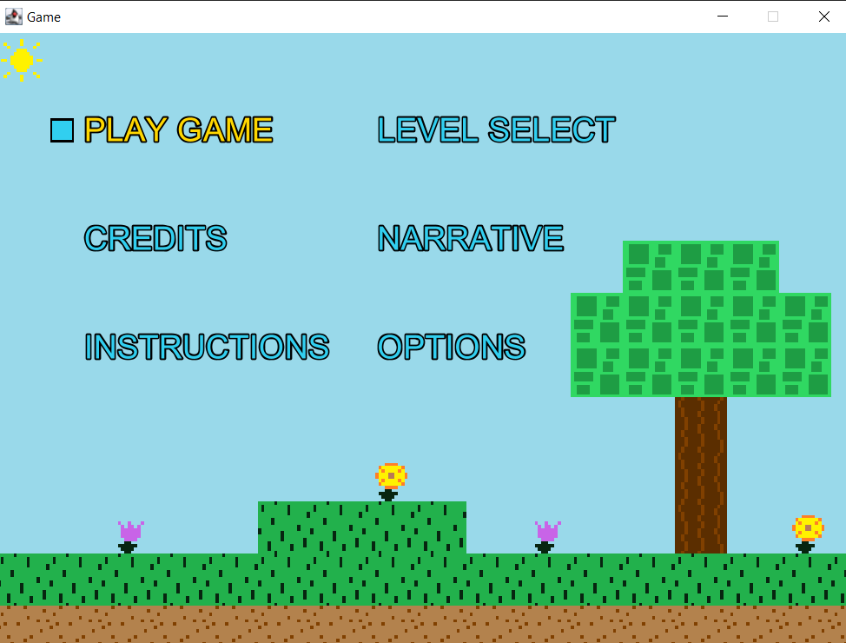
Mute Button - User Story
As a Player I want to have a mute button so that I can silence the music if I want.

Slide 17
Mute Button - Test Case
Steps:
Press “M”
Press “M”
Ensure “PLAY GAME” is chosen and press the spacebar to confirm choice
Press “M”
Press “M”
Use Game Controls to hit the Yellow Block to proceed to the next level
Repeat Steps 4-6 for all levels
Expected Results:
“M” key mutes the music
“M” key unmutes the music
Level 1 successfully starts
“M” key mutes the music
“M” key unmutes the music
Player enters the next level
“M” key mutes and unmutes the music

Slide 18

This Concludes Our Report
Thank You for Time

